Slide 1
DOUBLE AXIS SOLAR TRACKER
Guided by :-
Prof. Santosh Kedari

Slide 2
Group members
Abhijit Gawai
Prashil Jambhulkar
Saumitra Godbole
Hanzala Jamshed
Abhishek Hawaldar
Himanshu Pandey

Slide 3
Need for the project:
Energy crisis is the biggest crisis we are facing today and the biggest hinderence to development of our country
With the increasing demand for energy our only solution is to go green with renewable sources like solar energy.
However people are sceptical about solar energy because of its limitations such as it's efficiency.
Hence we have come up with a solution which will increase the efficiency of solar panels

Slide 4
Components used
Arduino UNO Board
Two 150 rpm DC motor
Solar plate
Four IR sensors
Four LDR's
One 9v battery
Wires

Slide 5
Working Mechanism:
Our project will detect the direction from where the sun rays are arriving.
This will be done by using a combination of light detectors.
Once this information is obtained ,it will be fed to the motor, which will rotate the solar panels through a certain angle so that the solar panel recieves optimum amount of energy.
Hence the solar panels will recieve more amount of solar energy thereby increasing it's efficiency

Slide 6
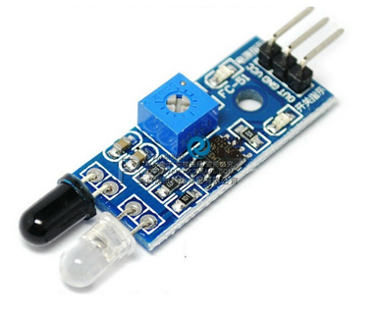
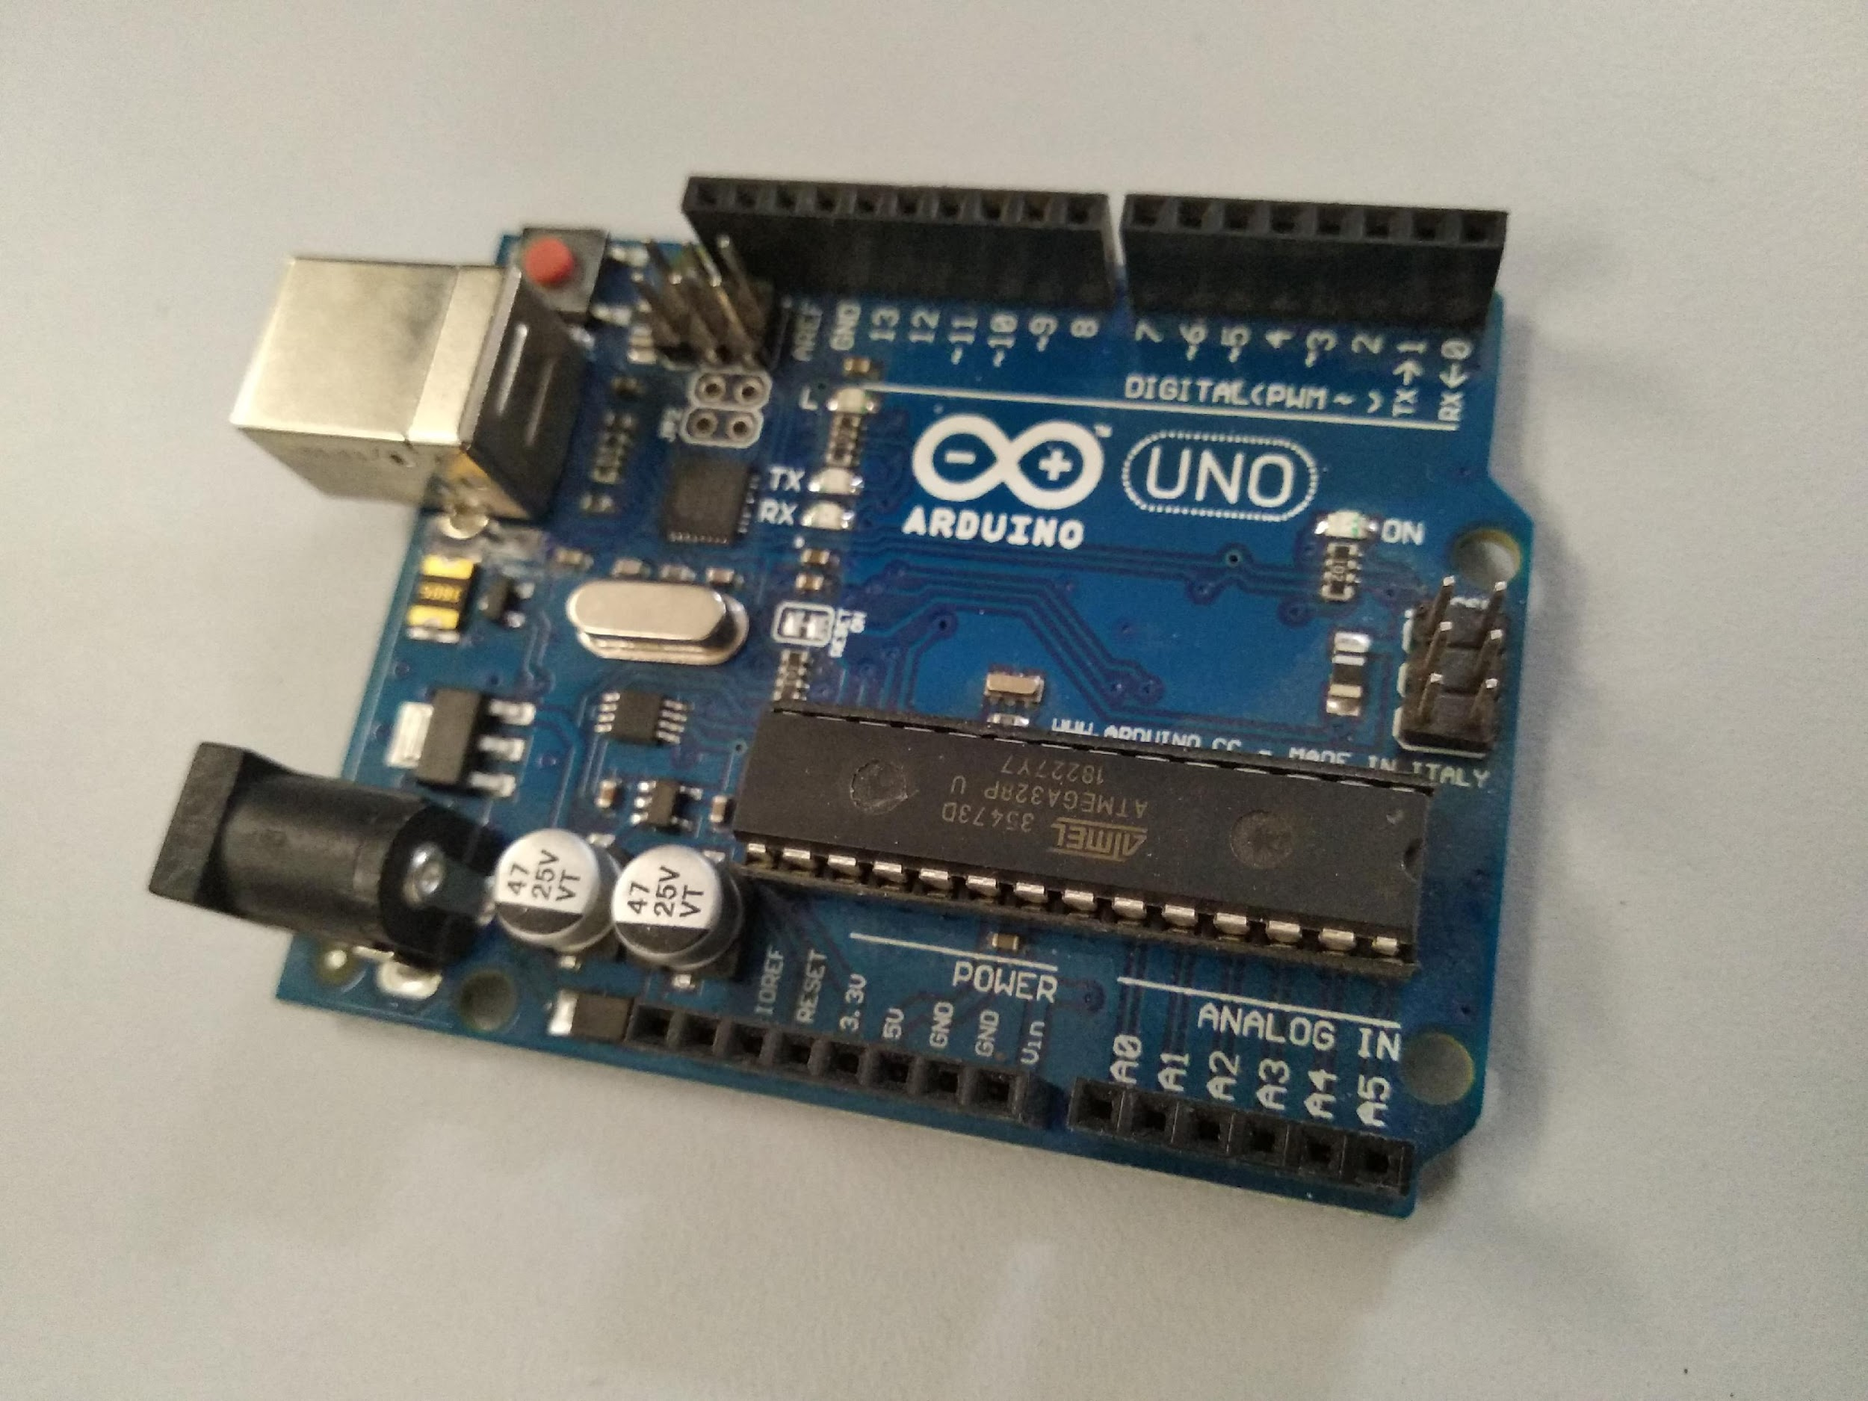
ARDUINO UNO and IR sensor

Slide 7
Advantages:
Generate more electricity than stationary solar cell.
Solar trackers generate more power in same surface area making them ideal for optimizing land usage.
Decreases the loss due to reflection of sunlight.
Not suitable for typical residential rooftop.
More expensive than stationary solar cell.
Needs frequent maintenance.
Tracking can also cause shading problems.
Drawbacks:

Slide 8
Scope for improvement
The base can be made more sturdy so as to withstand modest winds.
The coatings of the solar panel can be improved to decrease the loses due to reflection.
IR sensors and Arduino can be made water proof by putting them in an enclosure.
The efficiency can be increased by detailed study on the location of application.

Slide 9
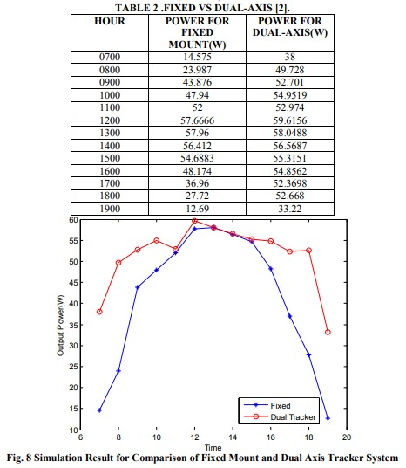
Efficiency Increment Data

Slide 10
Expenditure
Arduino Uno Board
Four IR Sensors
Solar plate
Four LDRs
One 9v battery
Wires
Other expenses
Rs 440
Rs 280
Rs 600
Rs 28
Rs 30
Rs 30
Rs 40
TOTAL: Rs 1450

Slide 11
THANK YOU

